Slide 1
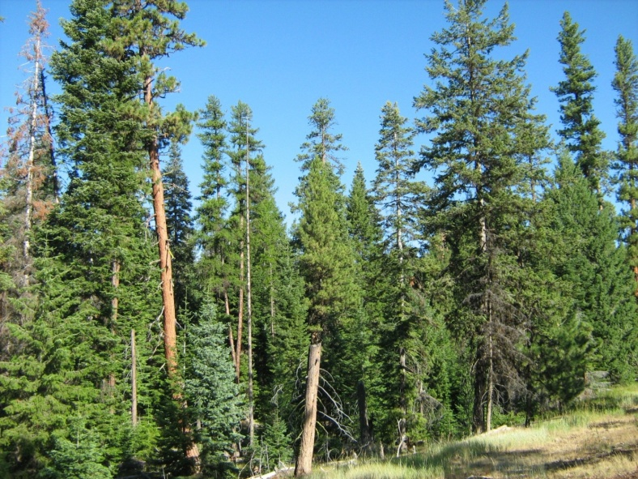
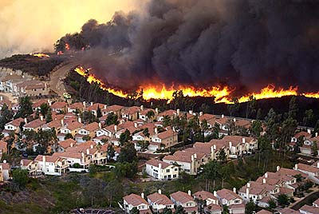
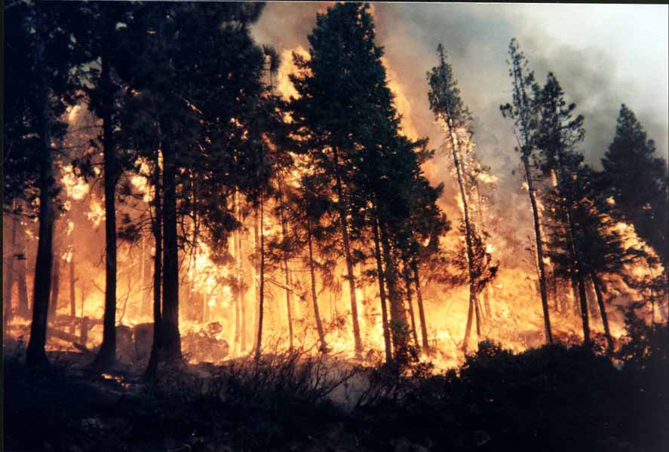




An introduction to the
Forest People Fire Project
FPF

Slide 2
The “Problem” of wildfire policy and management
Not just of fire alone, ecology alone or people
Not just about fire protection or forest restoration
Not just a stand/site problem
Can’t assume constant climate
The problem is really about
  Managing dynamic, multi-scale landscapes with socio-ecological interactions

Slide 3
Landscapes are large and heterogeneous
Vegetation (Cover)
Ownership
WUI
Habitat (NSO)

Slide 4
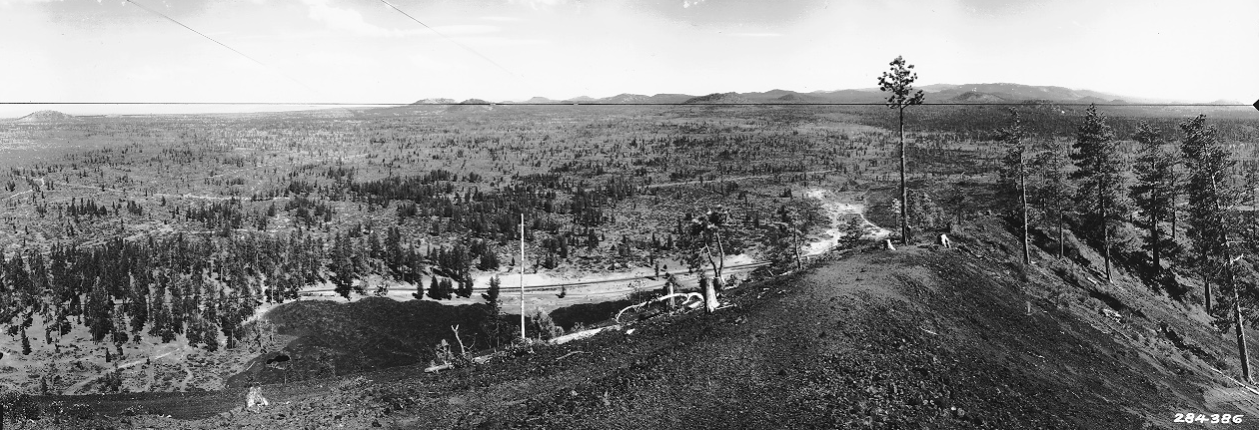
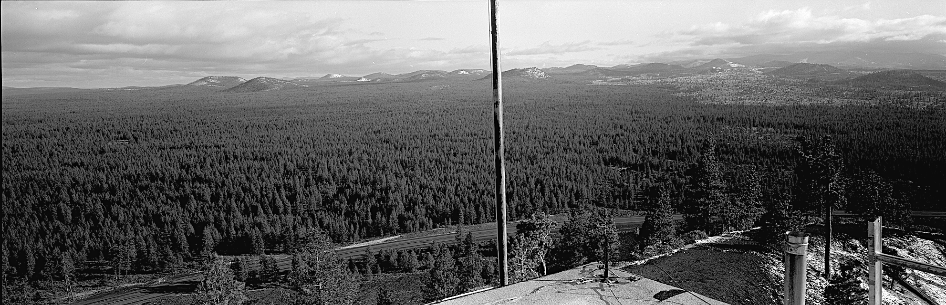
Landscapes change over time
1933
Wildfire History
View East from Lava Butte Lookout
Courtesy John Allen
1990

Slide 5
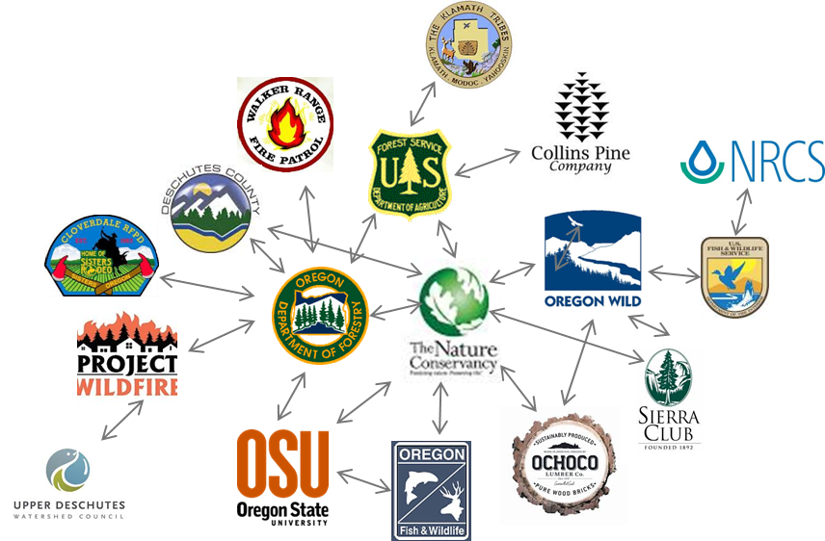
Social landscapes
Not necessarily spatial, but still large and heterogeneous
Paige Fischer

Slide 6
We need new information and tools to help us understand landscapes as:
Large and heterogeneous systems
Dynamic—both slow and fast
View through different perspectives
Interactions between social and ecological systems
Subject to unpredictable events/forces (e.g. fire, markets, climate change)

Slide 7
FPF Project
Understand coupled human and natural systems in fire prone landscapes
Develop agent-based model to help us explore ecological and social landscapes
Develop new social science information about risk perception, management behavior and social networks
Engage in joint learning with stakeholders

Slide 8
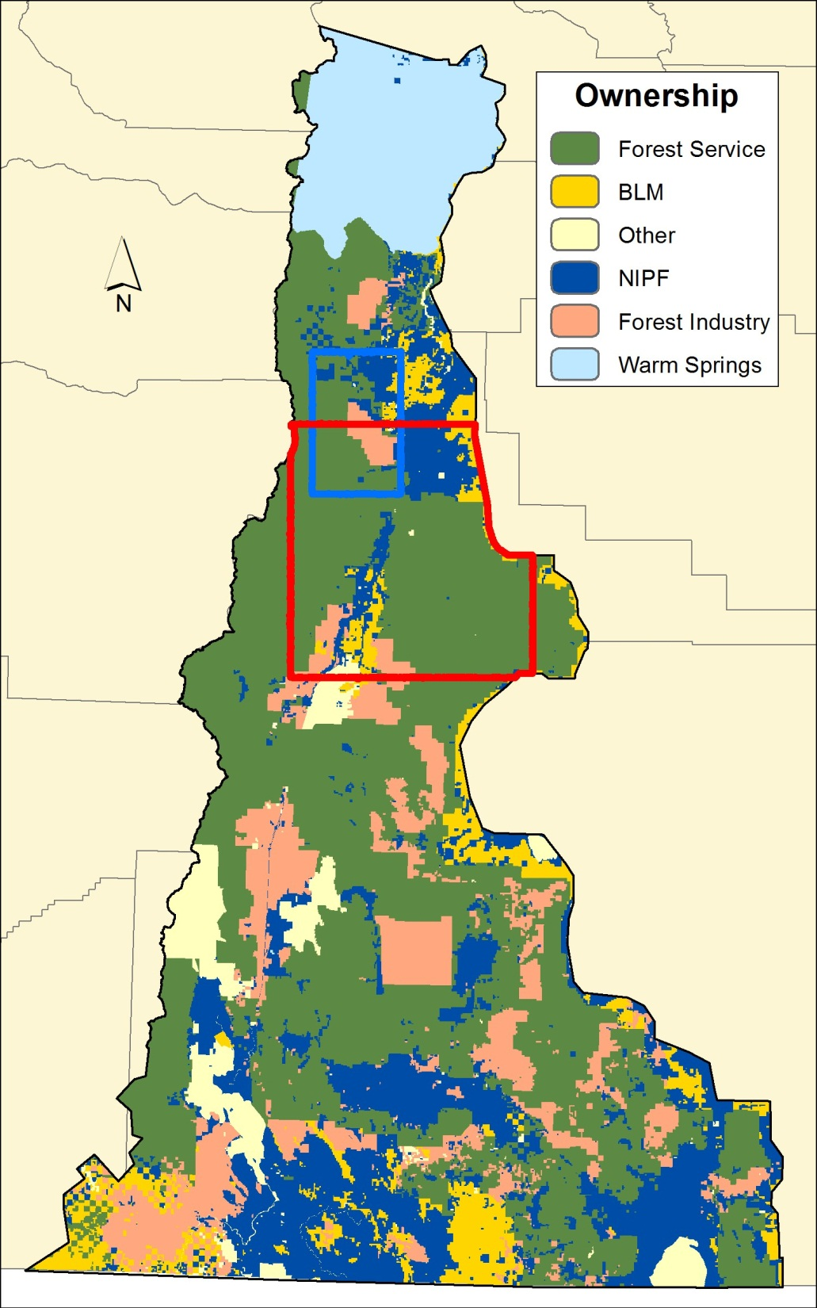
Ownership
Other 5%
Warm Springs 8%
NIPF 20%
Corporate
12%
USFS 48%
BLM 7%

Slide 9
External Drivers
Climate change, population growth
External Drivers
Forest policies, markets
Other Change Processes
Vegetation succession, fire behavior, housing expansion
Actors
DecisionMaking
US Forest Service,
Bureau of Land Management,
State of Oregon
Social Networks
Volume/
area targets
with constraints and preferences
Actions
Cut trees,
Reduce surface fuels,
Firewise homes,
Develop land
Conservation
Forest Products
Corporate forest owners
Tribes
Landscape
Condition
Government
Home-
owner
Non-industrial forest owners
Fire Protection
Owner preferences and values
Homeowners
Landscape Outputs
Forest products, terrestrial biodiversity, wildlife habitat, landscape amenities, fire area, fire hazard, carbon

Slide 10
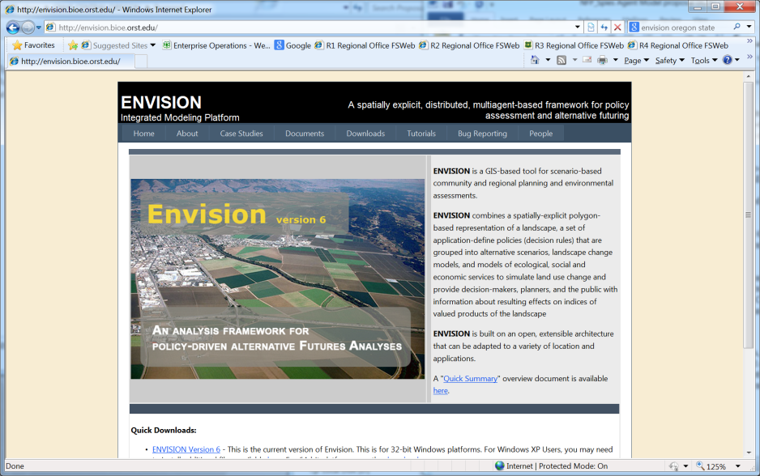
FPF Envision Model
Fire Behavior (Flammap)
Forest succession (VDDT)
WUI Growth
Management actions of different owners
Effects of climate on fire
Effects on wildlife habitat, wood, losses to fire, smoke, etc.

Slide 11
Spatial, Dynamic Landscape Models
Visualize scenarios
Evaluate Policies and Assumptions
Stochastic—Fire, succession
Reveal surprises, unintended consequences

Slide 12
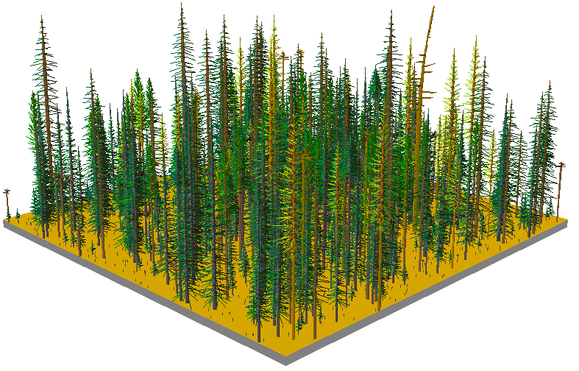

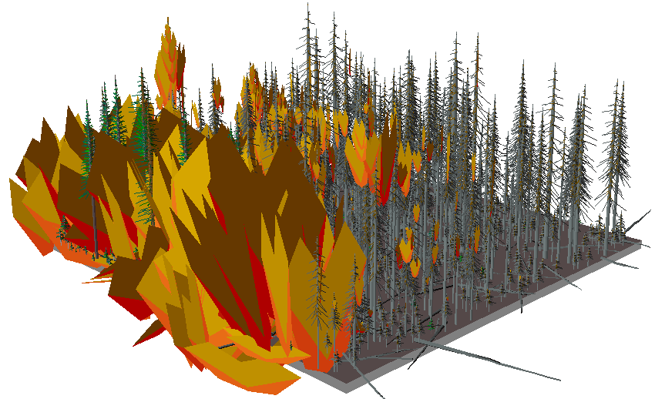
Wildfire Behavior in Envision
Minimum Travel Time Method
Alan Ager

Slide 13
Model Outputs (Story Lines)
Wood Production
Bioenergy
Carbon
Human Structure in WUI
Exposure of people to fire
Firewise
Fire potential at different severity classes
Fire occurrence and effects
Forest Structure
Wildlife/Biodiversity
Smoke
Amenities (visual)

Slide 14
Scenarios Analysis
Impossibility of predicting future
NOT PREDICTIONS
Possible futures to identify drivers and create better policies and practices
Visualization tools for understanding
Focal point for community engagement

Slide 15
Examples of Possible Scenarios
Scenario Theme | Characteristics
Status Quo | Current policies Limited biomass Current fire frequency Current population trend Current budgets and level of forest management
“Resilient” Forest | Integrated landscape policy More fuel treatment More landscape restoration Biomass utilization
Loss of management capacity (No Management) | Lack of funding for management Lack of mill capacity
Climate Change | More fire Increased levels of adaptation

Slide 16
Research Team
Tom Spies, Co-lead, PNW
John Bolte, Co-lead, OSU
Jo Albers, OSU
Alan Ager, PNW
John Bailey, OSU
Adam Callahan, OSU
Susan Charnley, PNW
Sally Duncan, OSU
Paige Fischer, PNW
Roger Hammer, OSU
Derric Jacobs, OSU
Jeff Kline, PNW
Christine Olsen, OSU
Keith Olsen, OSU
Rob Pabst, OSU
Emily Platt, OSU
Bruce Shindler, OSU
Brent Steel, OSU
Michele Steen-Adams, UNE
James Sulzman, OSU
Cynthia Schwartz, OSU
Eric White, OSU

Slide 17
Questions ?

