Slide 1
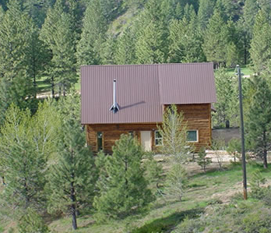
Fuel reduction and defensible space activities among private landowners
Jeff Kline
Christine Olsen
Eric White
Paige Fischer
Alan Ager
Notes:
Title
Other people/roles

Slide 2
External Drivers
Climate change, population growth
External Drivers
Forest policies, markets
Other Change Processes
Vegetation succession, fire behavior, housing expansion
Actors
DecisionMaking
US Forest Service,
Bureau of Land Management,
State of Oregon
Social Networks
Volume/
area targets
with constraints and preferences
Actions
Cut trees,
Reduce surface fuels,
Firewise homes,
Develop land
Conservation
Forest Products
Corporate forest owners
Tribes
Landscape
Condition
Government
Home-
owner
Non-industrial forest owners
Fire Protection
Landowner preferences and values
Homeowners
Landscape Outputs
Forest products, terrestrial biodiversity, wildlife habitat, landscape amenities, fire area, fire hazard, carbon
Notes:
Place in larger study:
Nonindustrial private forest landowner and homeowner activities to reduce wildfire risk
External drivers
Role of social networks
Landscape feedbacks

Slide 3
Conclusions
• Perceived wildfire risk and mitigation effort are sensitive to fuel conditions on the ground:
Trees per hectare
Probability of wildfire
Chance of damage to property or home
• Property owners with past wildfire experiences perceive greater risk and are more likely to take mitigation actions
Notes:
The conclusions we draw from this latest work are consistent with those of the first study I mentioned
Homeowners wildfire risk perceptions are shown to be correlated with hazardous fuel conditions predicted by fuel models
Perceived chance of wildfire positively correlated with actual probability of wildfire
Perceived chance of damage positively correlated with potential wildfire intensity
Risk perceptions also are correlated with past wildfire experiences
Conclusions indicate the possibility that like forest owners, these homeowners may be savvy observers of landscape conditions and that these “landscape feedbacks” enhance homeowners’ concerns about wildfire hazard and motivate them to take mitigation action
Or that homeowners living in particularly hazardous areas are receiving the message that they need to take protective measures to ensure their own safety

Slide 4
Conclusions
• Information from local government agencies appears to have little influence on wildfire risk perception by homeowners
But information from fire awareness groups does appear to have an effect
• Information from both local government and fire awareness groups appears to have a positive influence on homeowners’ risk mitigation efforts
Notes:
Advice from friends, family, and local government agencies appears to have little if any influence on wildfire risk perceptions among homeowners
However, advice from local government and fire awareness groups appears to have an influence on whether homeowners undertake Firewise activities
This suggests that while information from various entities may not be having a strong influence on homeowners degree of concern about wildfire, it may be effective by suggesting things that homeowners can do to address their exposure to wildfire hazard
I suspect that people living in these fire-prone landscapes tend to be fairly well aware of the risks they face and so this is the reason we see little influence from social context on risk perceptions
Where their information may be lacking is in knowing what to do to address wildfire risk
What appears to be useful from a policy perceptive, is making sure that homeowners have the knowledge and the physical and financial capacity to conduct Firewise activities to make the home site more resilient to wildfires that occur

Slide 5
Factors influencing mitigation behavior
Wildfire hazard
Values at risk
Perceived wildfire risk
Past wildfire experience
Protective action
Capacity
Social context
Perceived responsibility
Notes:
Our thinking began with work Paige Fischer and I did with her survey data from landowners in eastern Oregon’s ponderosa pine region.
We began with a conceptual framework that encompassed social science literature with respect to natural hazards and risk mitigation
READ
Paige had asked landowners whether they had conducted activities to reduce fuel on their properties in the past five years.
She also asked them how concerned they were about wildfire occurring on their property.
We used landowners’ responses to that “concern” question as an indicator of perceived wildfire risk
We found it correlated with whether landowners reduced fuel
And also correlated that with variables describing these other identified factors
Remember framework--Christine will return to it in few minutes.

Slide 6
Approach
Two surveys:
  Nonindustrial private forest landowners in
  study region.
  Homeowners in wildland-urban interface
  areas in study region.
Notes:
We did this using three surveys.
One survey, conducted by Paige Fischer a few years ago, asked nonindustrial private forest landowners located in Oregon’s ponderosa pine region about their concern about wildfire and activities to mitigate risk.
A second survey completed last year generalized a similar set of questions for all nonindustrial private forest landowners in our central and south-central Oregon study region.
And in a third survey, which Christine will talk about in a few minutes, we asked homeowners in wildland-urban interface of our study region about their wildfire risk perceptions and defensible space activities.

Slide 7
Non-industrial private forest landowners
Parcel size of 2.5 acres or more
At least 10% forested
Ranches and LLC entities (non-timber) included
11,000 NIPF taxlots
Notes:
Paige and my work with the ponderosa pine region forms a foundation for the landowner and homeowner behavior modeling going forward.
However, the survey data Paige and I examined was specific to the ponderosa pine region
We needed information about landowners in other vegetation types and so we conducted a survey of nonindustrial private forest landowners specific to our central and south-central Oregon the study region
Focus on . . . READ
Analysis of this particular survey is less developed than that for the homeowners, but will share some initial findings about fuel reduction activities and factors that influence them.

Slide 8
Factors influencing fuel reduction among NIPF owners
Factor | Effect
Trees per hectare | +
Past wildfire within miles | ++
Insect infestation nearby | ++
Forest Service information | +
Structure on the property | +++
Notes:
Factors we identified that appear to most influence whether landowners in the study region conduct fuel reduction activities are
READ
Early results suggest that influencing factors may be more diverse for this general group of forest landowners than was the case with the survey limited to just ponderosa pine landowners.
Still see influence of landscape feedbacks in terms of stand density, and past disturbances as factors that motivate landowners to reduce fuel.
In future analysis, we plan to take a look at the role that management and fuel conditions on neighboring lands—including private and federal lands—may play in motivating landowners to reduce fuel.
One of the key things we are learning in this work is that private landowners and homeowners appear to respond to a variety of factors when choosing to mitigate their exposure to wildfire risk.
And that they weigh these different factors in their risk mitigation decisions.

Slide 9
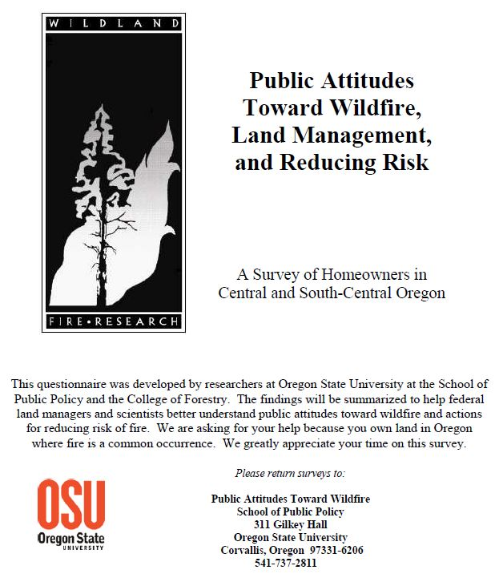
Homeowners
Survey in WUI
  Intermix
  Interface
Summer 2012 – before Pole Creek
531 responses
Notes:
So, having some success in anticipating nonindustrial forest owners’ fuel treatment activity, we turned to a second interest—understanding factors that influence Firewise activities among homeowners in the wildland-urban interface
Homeowners in this case included people living on much smaller parcels of under 10 acres, and on which reducing wildfire risk would involve manipulating landscaping around the home to reduce ladder fuels and making the home structure itself more fire-resistant
Data for analysis in this case came from survey of central Oregon homeowners, conducted in 2012 by co-author Christine Olsen.

Slide 10
Components of perceived wildfire risk among homeowners
Perceived chance
of wildfire
Perceived chance
of damage
x
=
Perceived wildfire risk
Notes:
We did this by explicitly recognizing two distinct components of perceived wildfire risk as
The likelihood of wildfire in the vicinity of the homeowner;
The likelihood of damage to the home in the event of wildfire.
We assume that together, these two factors combine to characterize the likelihood an individual homeowner feels that a wildfire could occur that damages the home
And so Christine’s survey asked homeowners about their perceptions of both of these factors.

Slide 11
Components of perceived wildfire risk among homeowners
Chance of wildfire (%)
Burn probability | +
Wildfire within miles | +++
Prescribed burn in miles | ++
Advice: family/neighbor
Advice: local govt/FD
Advice: fire awareness
Property owner
College-educated | +++
Chance of damage (%)
Conditional Flame length | ++
Trees per hectare | +++
Wildfire within miles | +++
Prescribed burn neighbor | +
Advice: family/neighbor
Advice: local government
Advice: fire awareness | +++
Notes:
We used logit transformation to regress “chance of wildfire” and “chance of damage” on variety of variables representing influencing factors hypothesized in conceptual framework
For both factors, we see evidence that the actual degree of hazard is correlated with homeowners perceptions of hazard
In the “chance of wildfire” equation, estimated burn probability is positively correlated with perceptions of wildfire likelihood
Burn probability in this case was the annual likelihood of burning given a random ignition in the study area, and was information co-author Alan Ager had developed using fire behavior models combined with actual fuel conditions surrounding each survey respondent’s home

Slide 12
Predicting Firewise activity
Firewise activity
Perceived wildfire risk | +
Wildfire in neighborhood | ++
Advice: family/neighbor
Advice: local government | +++
Advice: fire awareness | +++
Property owner | ++
Tenure | +
Age | --
HOA rule | +++
Notes:
For the Firewise equation, we used logit model to regress the likelihood that homeowners conducted Firewise activities on variables representing hypothesized factors
The “perceived wildfire risk” variable here is our “chance of wildfire” multiplied by the “chance of damage” as perceived by respondents.
We found it to have a positive significant correlation with the likelihood that homeowners had conducted Firewise activities
That’s to be expected—homeowners who perceive greater risk are more likely to try to do something to reduce that risk
Past wildfire experience again we found influenced the likelihood of past Firewise activities, with a strong positive relationship

Slide 13
Policy implications
• Property owners seem to understand the wildfire risks they face in this fire-prone landscape
But some owners can use assistance with how to mitigate wildfire risk
• Uncertain what types of assistance or other incentives might be most effective for inducing greater mitigation effort
Information, cost-sharing, technical assistance

Slide 14
56% of NIPF owners reduce fuel
Activity | %
Mow, prescribe burn, thin | 13%
Mow, prescribe burn | 1%
Mow, thin | 36%
Prescribe burn, thin | 9%
Mow only | 22%
Thin only | 19%
Notes:
Overall for the study region, 56% of nonindustrial forest landowners say they have conducted activities to reduce fuel on their properties in the past five years.
READ
We allocate nonindustrial forest landowner activities according to these percentages . . .
After first using a regression model to predict whether landowners do anything to reduce fuel.

Slide 15
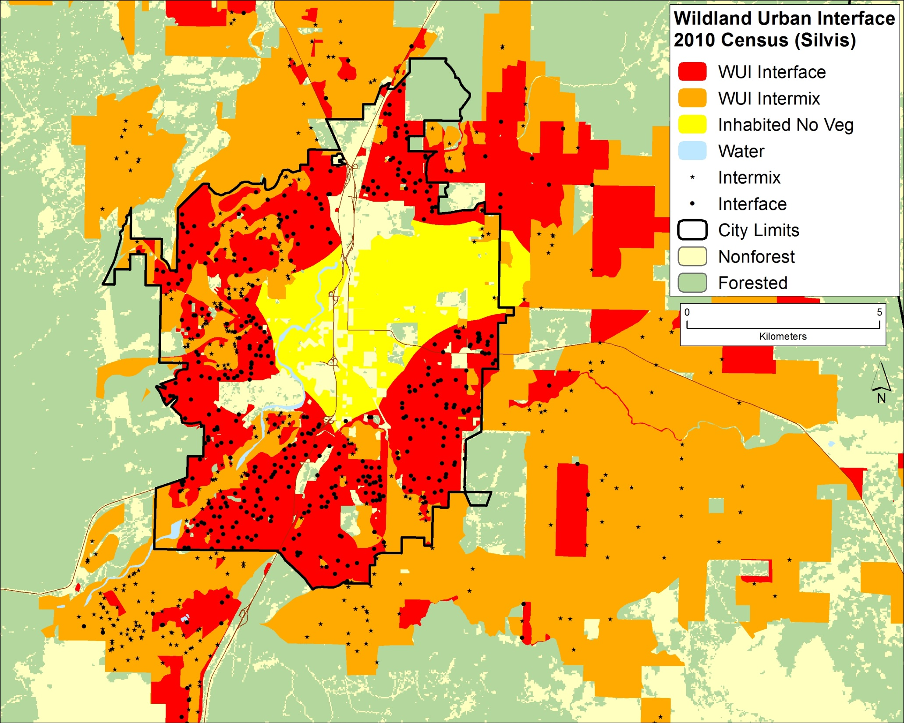
Bend
Keith Olsen
Notes:
Survey focused on homeowners in wildland-urban interface and intermix designations—so places like Bend, Oregon and other places where homes are encroaching on fire-prone forests
Looking at this map of Bend, where the red is wildland-urban interface and the orange is intermix, you can see that there are extensive areas of this jagged edge where homes extend into the surrounding dry-land forests

