Slide 1
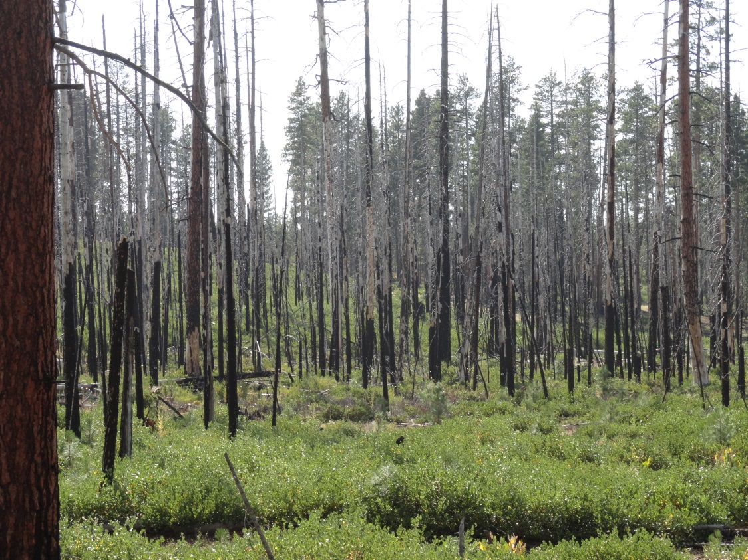
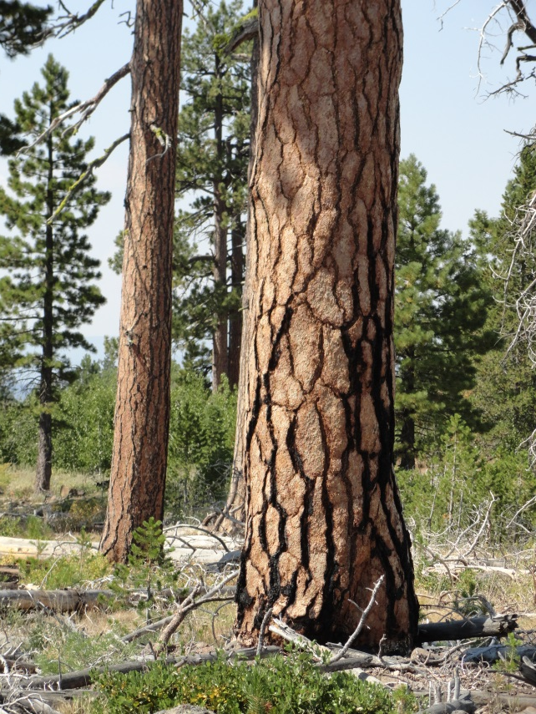
- Description of scenarios
No treatment
Status quo
Resilience
- Preliminary model results
- Management and decision making in Envision

Slide 2
 | Status Quo | Resilience | No Treatment
Acreage targets | Current levels | Based on historic fire return intervals | NA
Amount of management | ~ 1.4% per year | ~ 3.4% per year | None
Core management activities | Thinning Prescribed fire Mowing and grinding | Thinning Prescribed fire Lodgepole clear-cuts | None
Planning areas | Prioritized by basal area | Prioritized by fire hazard | NA
Management areas | Existing allocations applied (e.g. wilderness, LSR, CFLR, WUI) | Wilderness and PVTs applied | NA
Actors | Status quo for all actors | Applied to federal management | No treatment for all actors

Slide 3
Landscape View of Management, Year One
Resilience Scenario
Status Quo Scenario

Slide 4
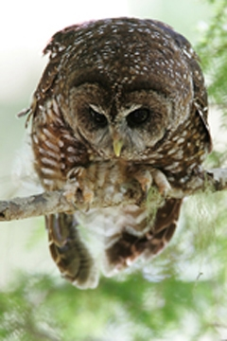
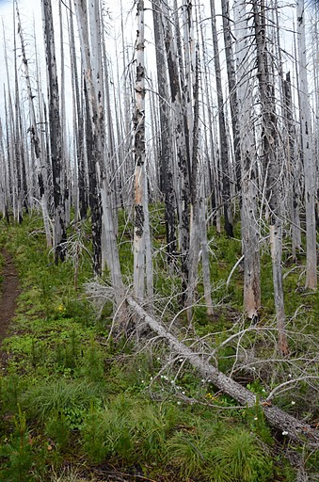
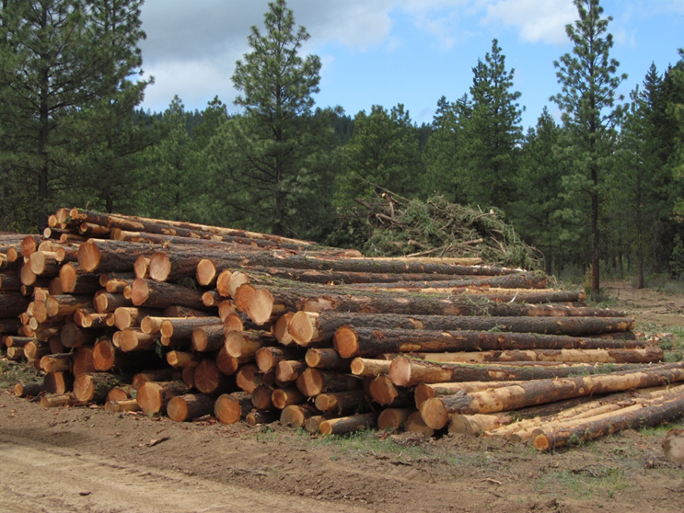
Results
Notes:
outputs for fire, wood products, and wildlife

Slide 5
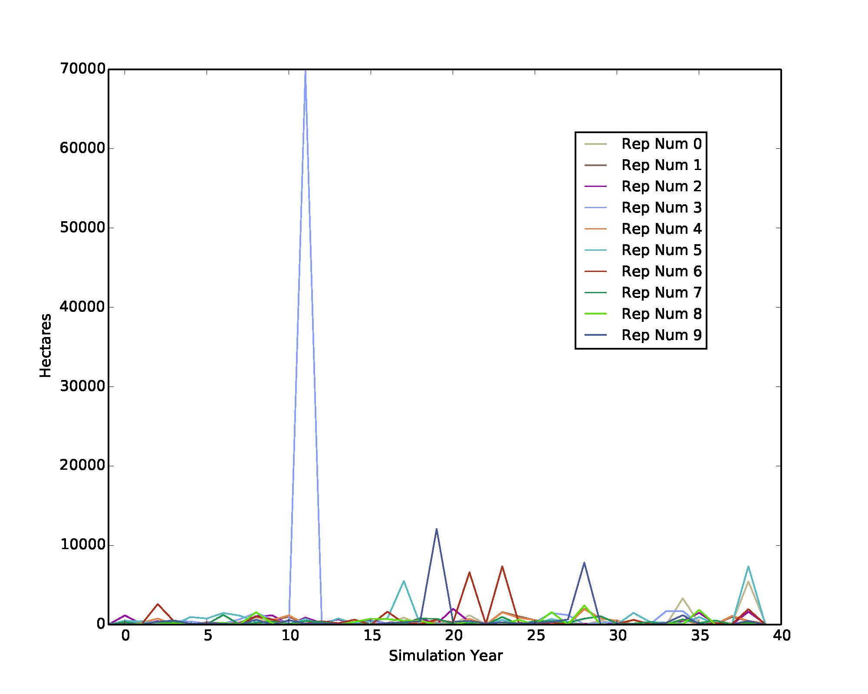
Stand Replacing Fire, 10 replicates
~ size of Pole Creek fire
~ size of Davis Lake fire

Slide 6
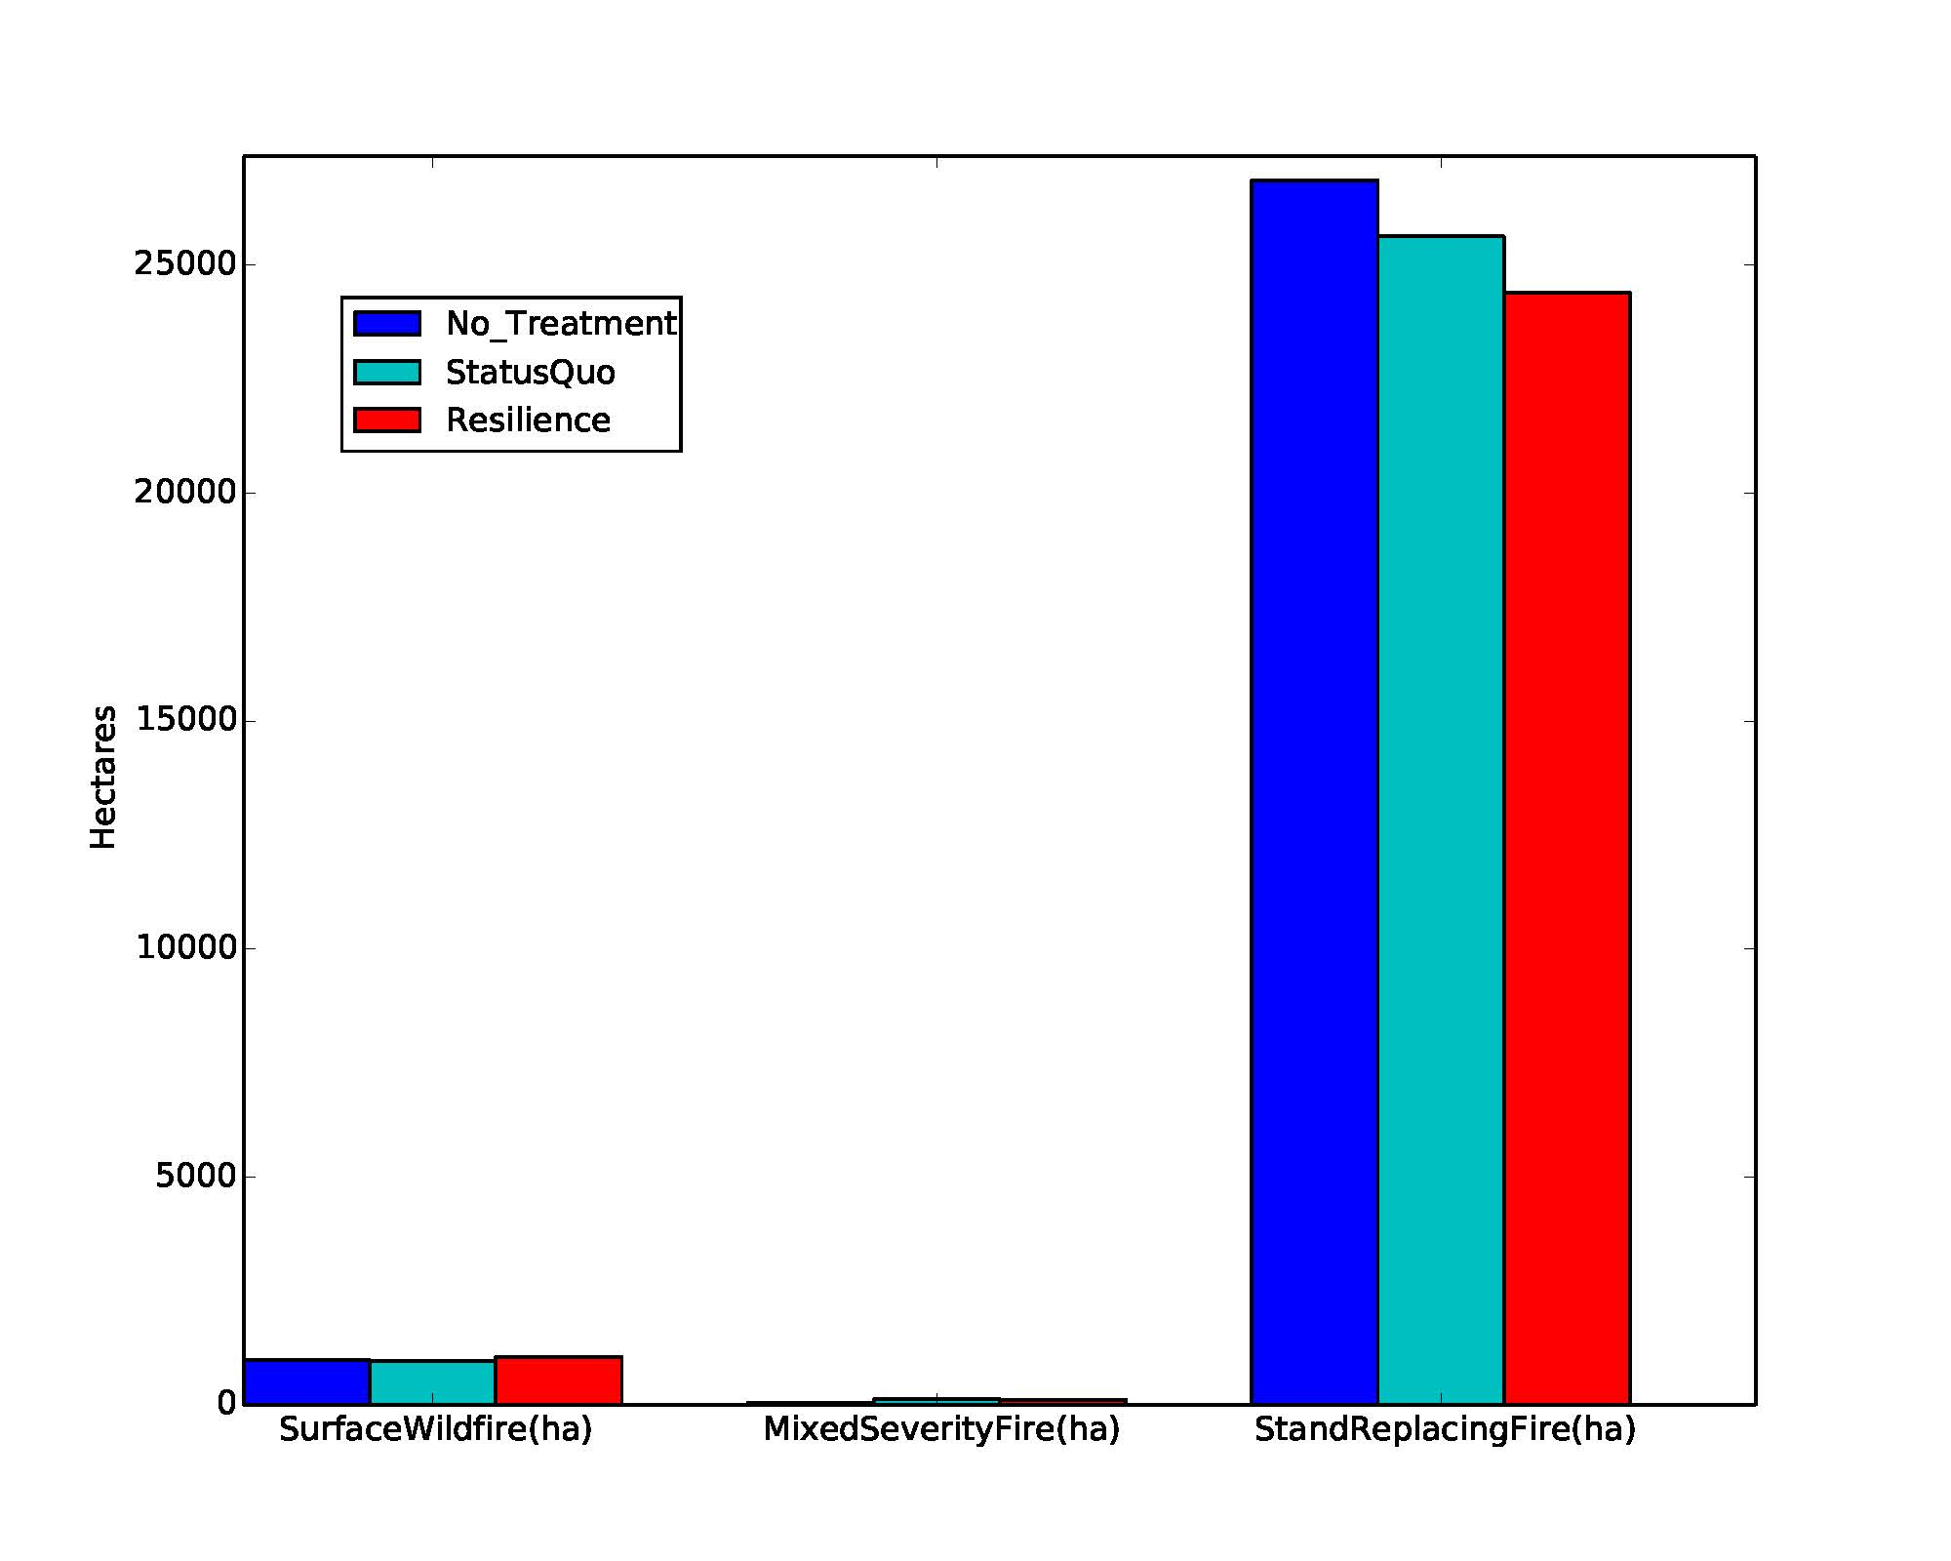
Cumulative Wildfire by Scenario

Slide 7
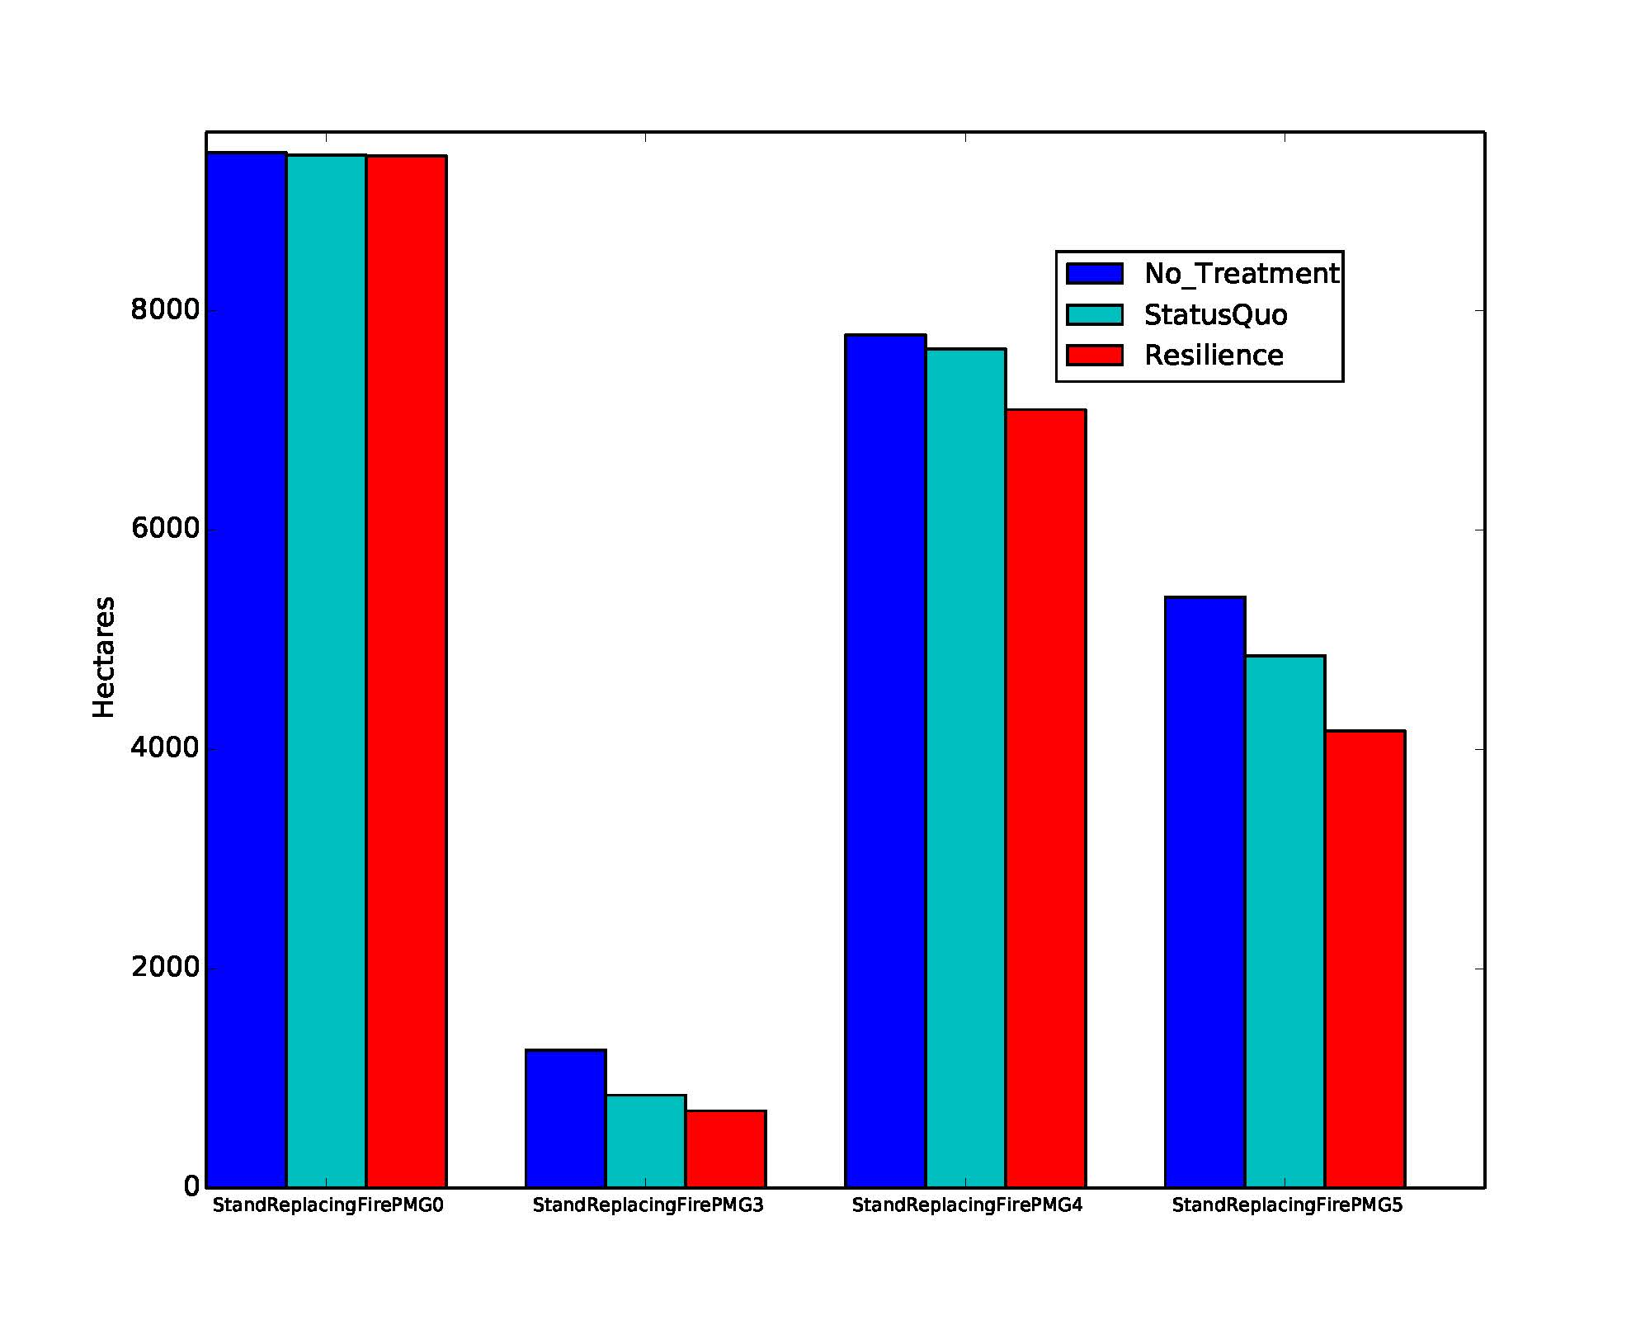
High Severity Fire by Scenario and Potential Vegetation Group
Arid lands
MMC
DMC
PPine

Slide 8
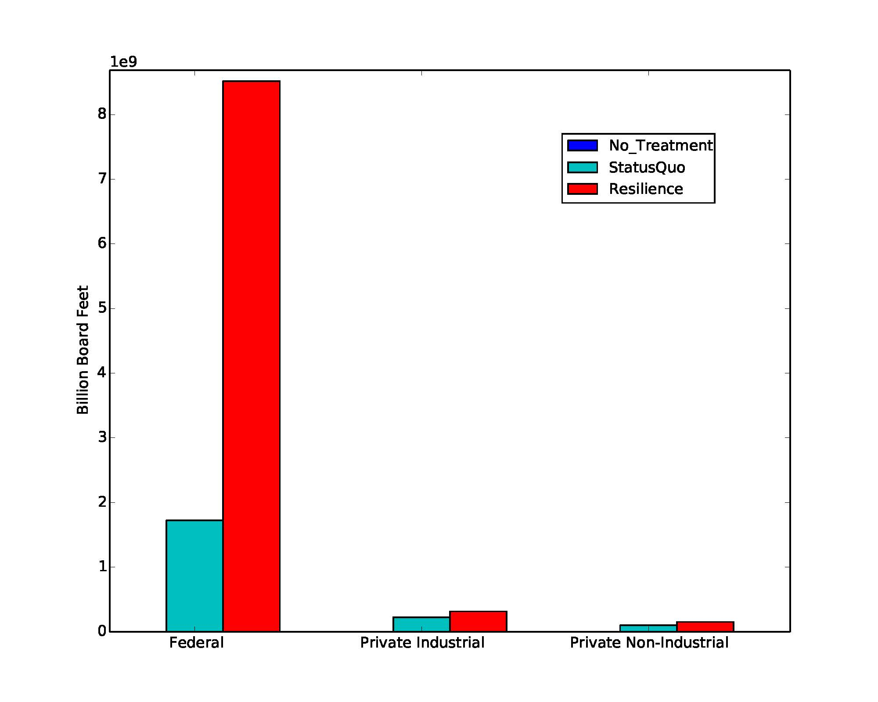
Cumulative Timber Volume by Scenario, 40 years
Notes:
Cumulative board feet over 40 year model period
47.5 mmbf/ yr for status quo scenario
222.5 mmbf/yr

Slide 9
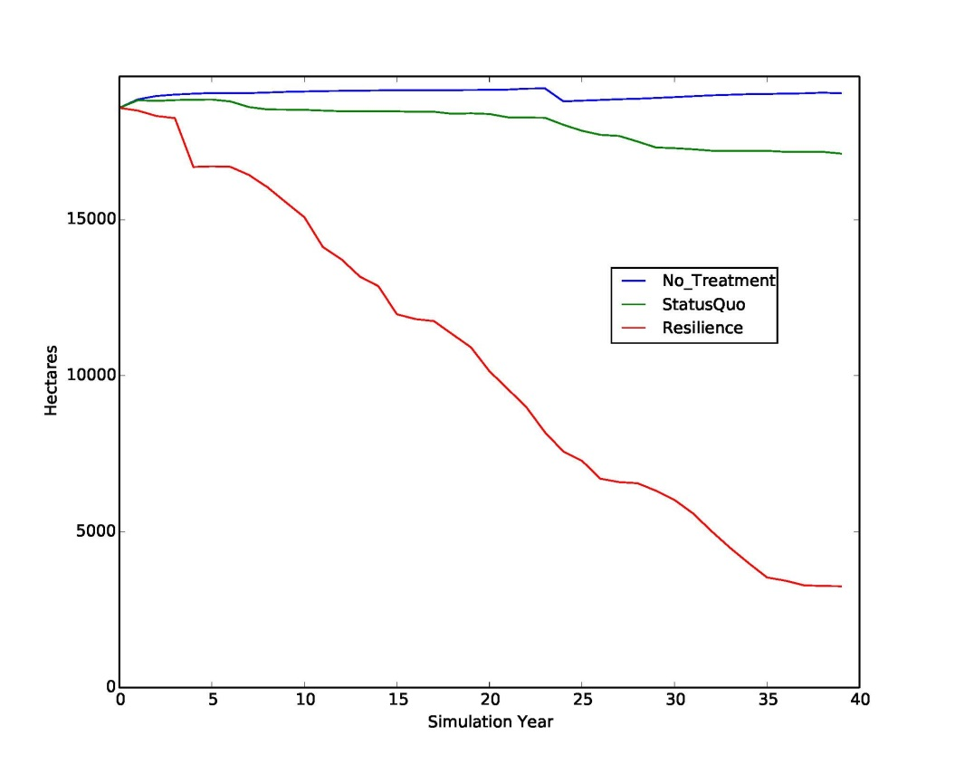
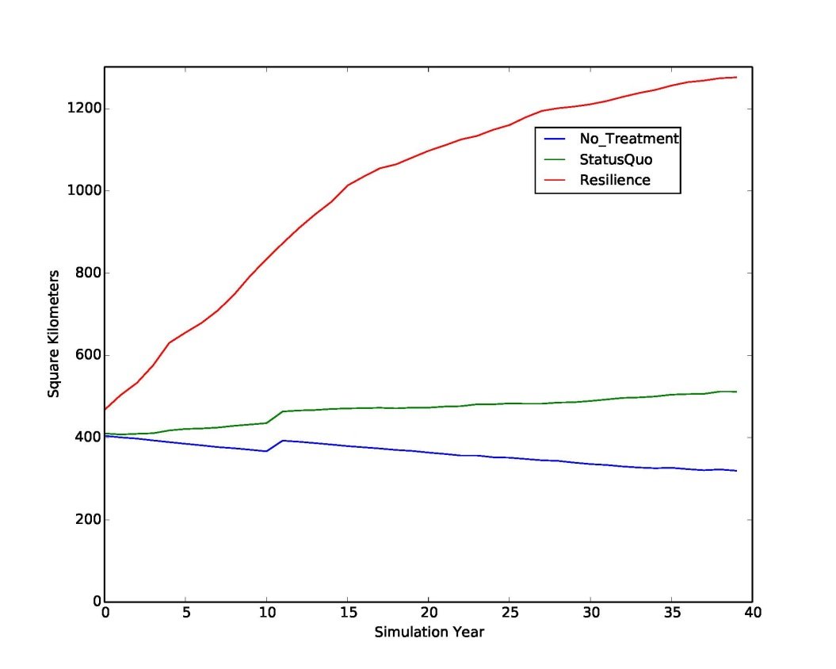
Habitat
Spotted Owl
average level of moderate and high suitability habitat , 10 replicates
Western Bluebird
average level of moderate and high suitability habitat, 10 replicates

Slide 10
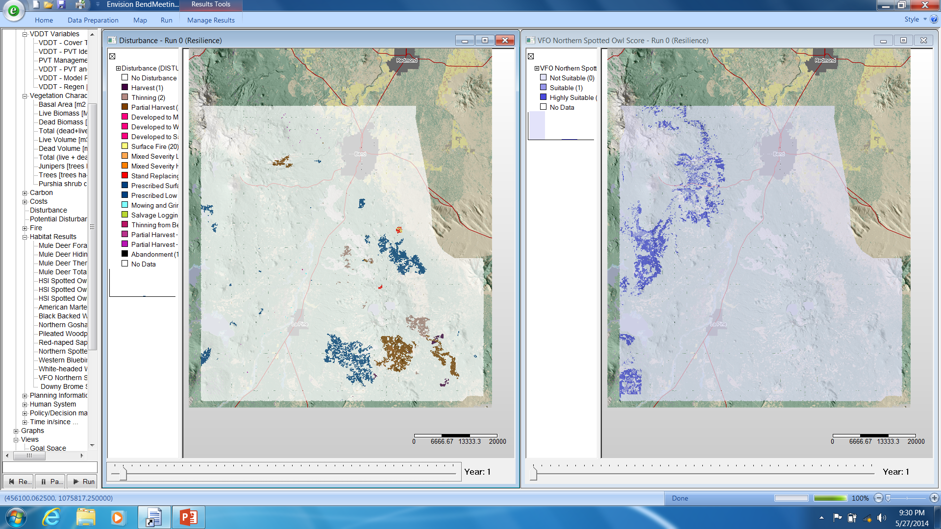
Resilience Scenario
Disturbance
Spotted Owl Habitat

Slide 11
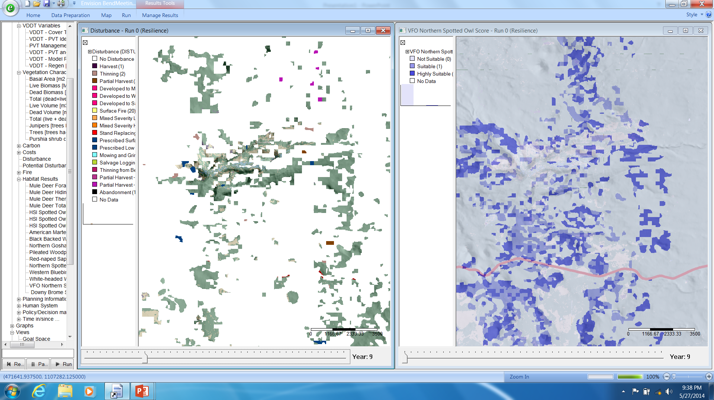
Disturbance
Spotted Owl Habitat
Notes:
Zoomed in. Year 9.

Slide 12
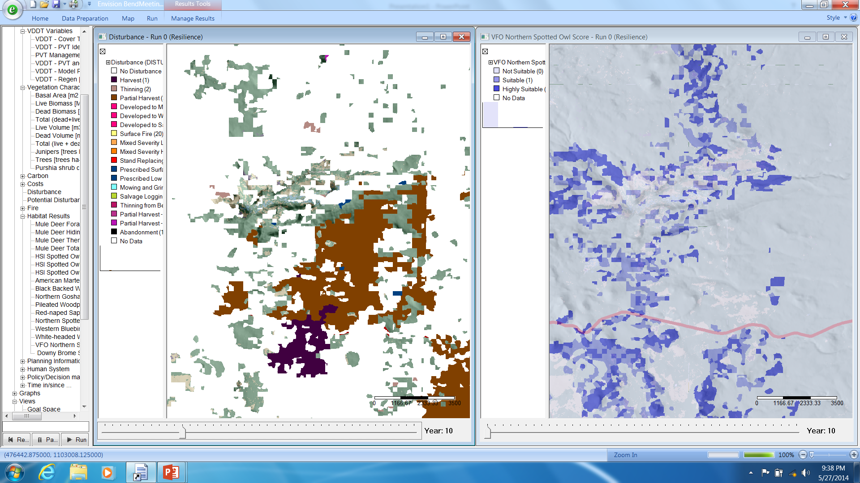
Disturbance
Spotted Owl Habitat

Slide 13
Notes:
John has a couple things to show live in Envision, and if anything else catches your eye …
Ok, so now that you’ve seen what the model can do, we wanted to describe a little more of how it works.
We’ll focus on the different actors in the model and then how they make management decisions.

Slide 14
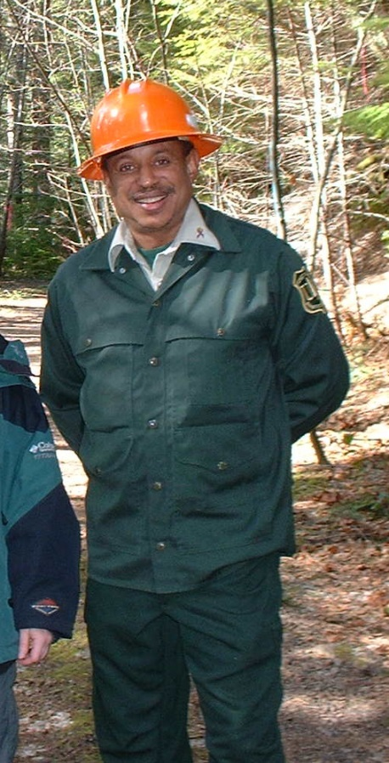
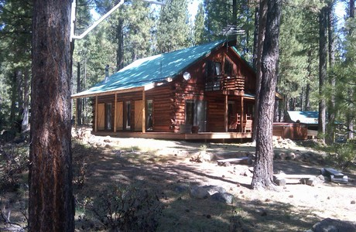
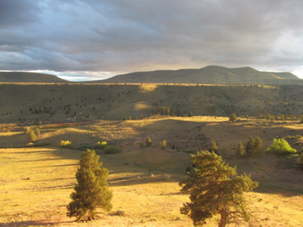
Actors
 | Thinning | Prescribe fire | Mow & grind | Clear-cut | Salvage log | Firewise homesite
Forest Service | x | x | x | x | x
Warm Springs | x | x | x | x | x
Corporate forestland owners | x | x | x | x | x
Non-industrial private | x | x | x |  |  | x
Homeowners |  |  |  |  |  | x

Slide 15
Empirical Econometric Models
Homeowners
Firewise = f ( perceived wildfire
risk, capacity, legal requirement )
Non-industrial private forestland
owners
Harvest = f ( basal area, parcel size )
Fuel treatment = f ( trees per hectare, fire within 10 km in past 5 years, insect infestation within 2 km in past 5 years, presence of a residential structure )

Slide 16
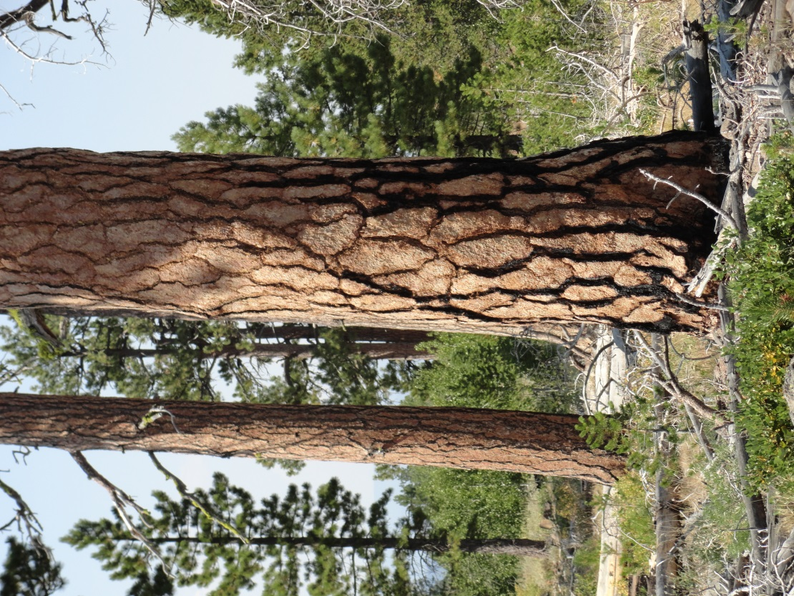
Large Landowner Decisions
Targets, constraints, and preferences
Private corporate Acreage target, minimum tree size, harvest rotation, basal area.
Warm Springs
Acreage targets based on forest type and management zones, harvest rotation, and stand age.
Forest Service
Acreage targets by district, constraints and preferences vary by management activity

Slide 17
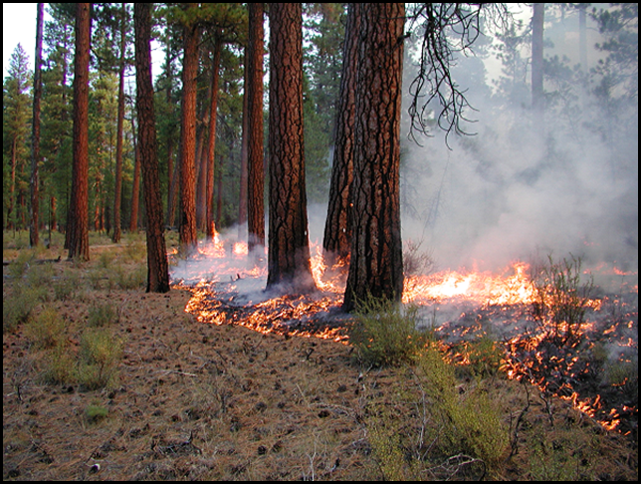
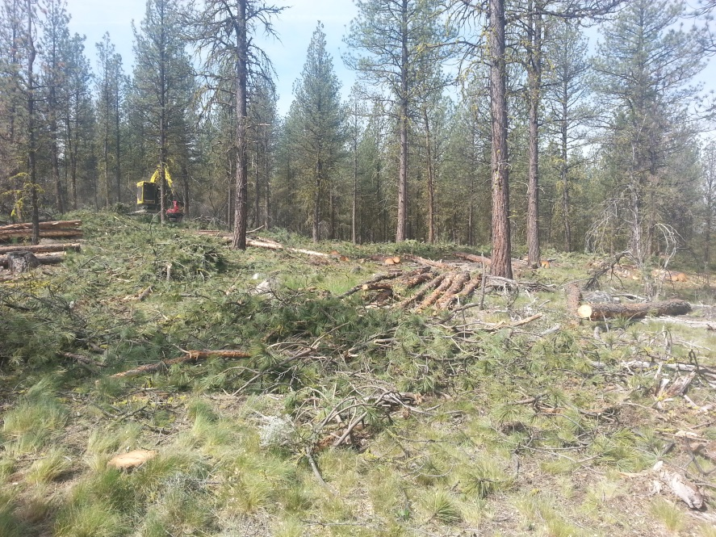
Large Landowner Decision Making
 | Scenario – Resilience |  |  | Scenario - Status Quo
Activity | thinning | prescribed fire |  | thinning | prescribed fire
Amount (acres) | 24,600 | 24,600 |  | 10,400 | 2,568
Planning Areas (ranked by) | fire hazard |  |  | basal area
Size of Activity Units (acres) | Varies by PVT |  | Varies by PVT | 70 |  | 100
Where - Constraints (0/1)
Wilderness | No | Yes | No | No
Ponderosa pine | Yes | Yes | Yes | Yes
Moist mixed conifer | Yes | Yes | Yes | No
Low cover and one layer | No | Yes | No | Yes
Photo courtesy of TNC
Where - Preferences (rank)
Ponderosa pine | +++ | +++ | +++ | +++
Large trees | ++ | ++ | - | +
Closed layered DMC | +++++ | --- | ++ | --
Closed layered MMC | +++ | ----- | - | -----
WUI | 0 | 0 | +++++ | +
LSR | 0 | 0 | ----- | -----
CFLR | + | + | ++++++ | ++++++
Photo courtesy of Patrick Shannon, SNW

Slide 18
-1
2
4
5
-4
1
8
-1
3
2
1
3
4
3
Notes:
Preference scores get added up and areas with the highest scores get selected first.

Slide 19
Conclusion
Model flexibility
Data
Many ways to build understanding of landscape change
Next Steps
Final model testing
Use model to test hypotheses on Bend project area
Run model on whole project area

